Slide 1
Application Development Orienting – Week 1
Introduction

Slide 2
Your Teacher
Mr. Basjan Schouwenaars (scwnrs)
b.schouwenaars@fontys.nl
Room 2.41

Slide 3
Some rules
Be on time
Too late for some reason? Sit down quietly!
Unable to attend?
Let me know before class starts
During class you work on the course
Put your phone on silent
No gaming, movies, etc.
Ask questions!

Slide 4

Content
Topics of this week
Introduction to ADO
Programming languages
Windows Forms Applications and basic Controls
Variables and Operators
Learning objectives
Create a WinForms application
Display and retrieve information using Controls
Store and manipulate that information using variables

Slide 5


Intro: ADO
12 weeks
2 x 1,5 hours theory and practical
2 x 1.5 hours guided self-study
Approx. 4 hours per week of additional self-study

Slide 6

Intro: ADO (continued)
Week 4 mandatory individual assignment
Week 6 paper exam.
Week 9 mandatory group (3 team members) assignment.
Week 12 laptop-exam.
At the end of the course you will receive a formative indication for ADO, i.e. Outstanding (O), Good (G), Satisfactory (S), Unsatisfactory (U) or Poor (P)

Slide 7

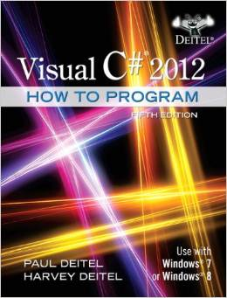



Intro: ADO (continued)
Resources:
Book C# for Students, by Douglas Bell and Mike Parr
Book Visual C# 2012, How To Program (Fifth Edition), by Paul Deitel & Harvey Deitel
Website Microsoft Docs (https://docs.microsoft.com/en-us/dotnet/csharp/)
Internet tutorials (e.g. Youtube)
Tool: Microsoft Visual Studio Enterprise
Notes:
Tool: latest available

Slide 8

Microsoft Visual Studio Enterprise
Go to Sharepoint - Student Square
Click on the link Azure Dev Tools for Teaching (Imagine)
Log on with you i-account
Look for Visual Studio Enterprise and download it (free)
Be sure to take note of the serial key!
Install Microsoft Visual Studio software OR
All of above to obtain the serial key, but copy content from a memory stick instead of downloading it

Slide 9
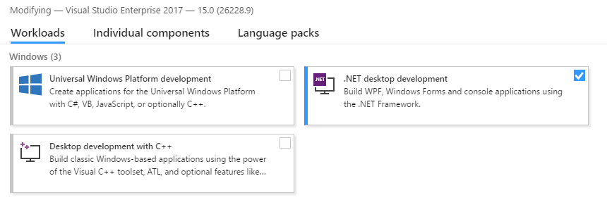
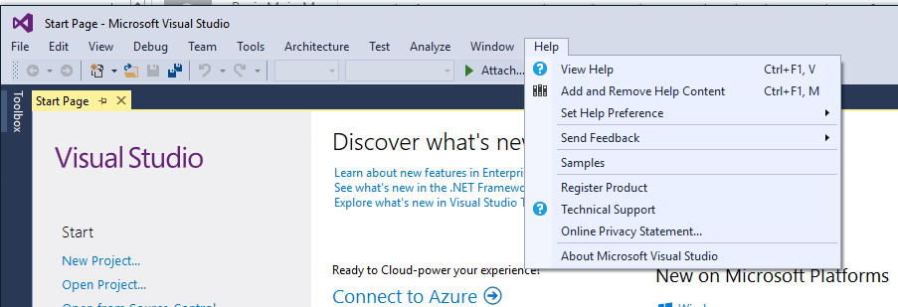
Installing Visual Studio

Slide 10

Questions?

Slide 11

Intro: What is a computer?

Slide 12
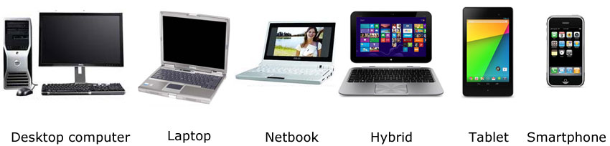
Intro: What is a computer?
A computer is a device that can be instructed to carry out arbitrary sequences of arithmetic or logical operations automatically. The ability of computers to follow generalized sets of operations, called programs, enables them to perform an extremely wide range of tasks.
(source: Wikipedia)

Slide 13
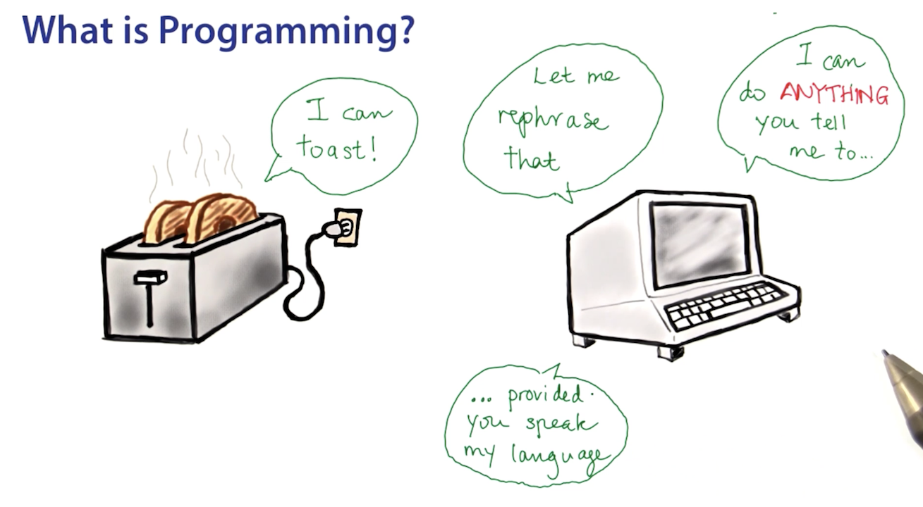
Intro: Programming a computer

Slide 14
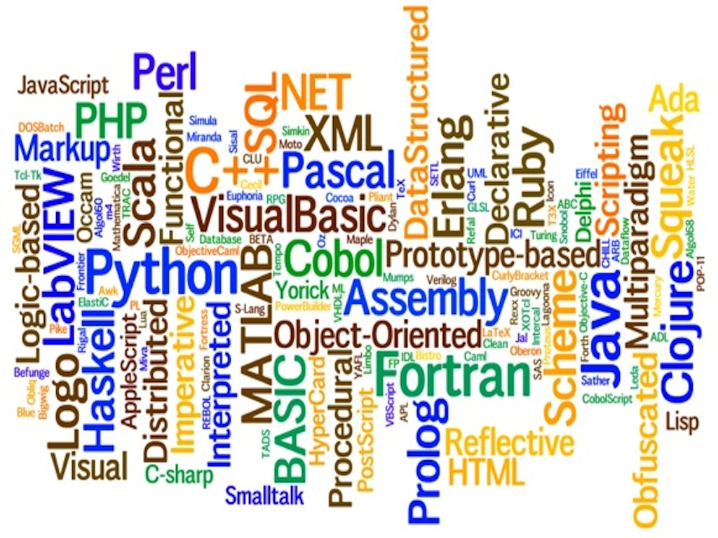
Intro: Programming Languages
Notes:
What do you think they stand for?

Slide 15
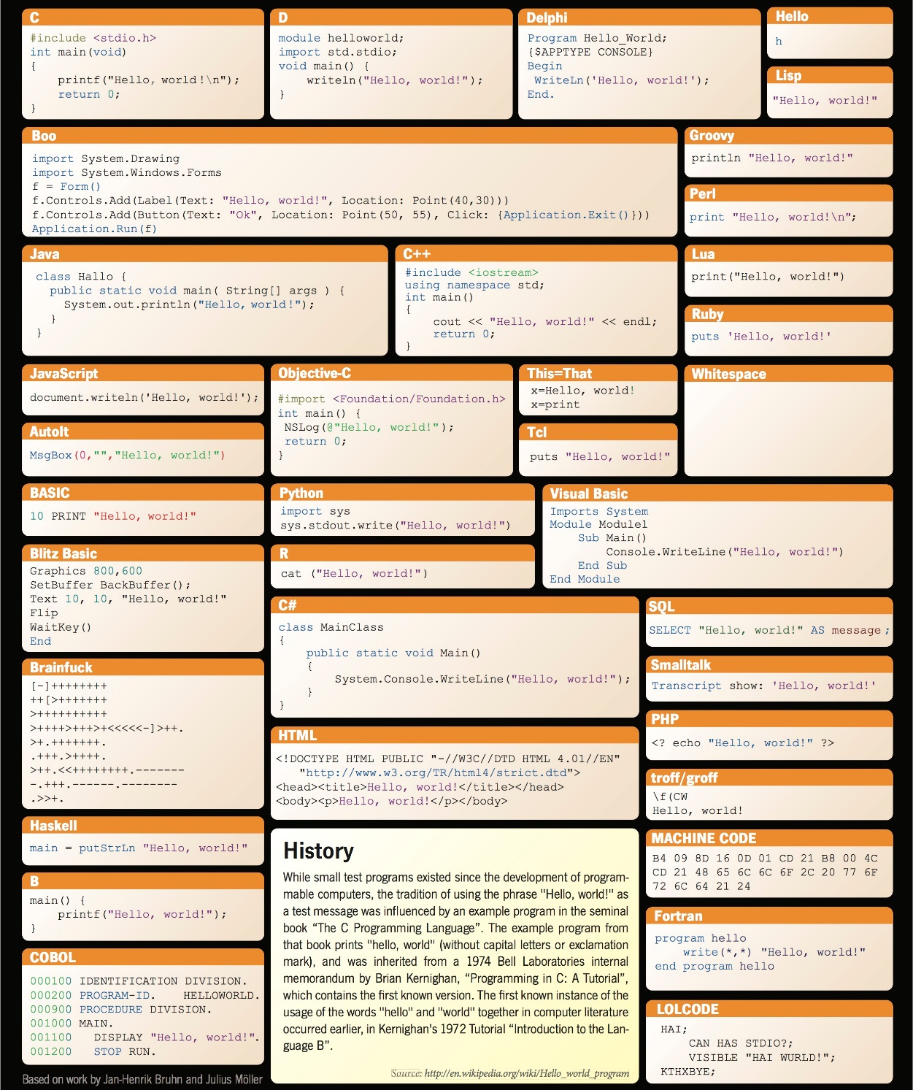
Hello, world!

Slide 16
Intro: Programming Languages (cont.)
Every programming language has:
Syntax: how do you write it? (structure or form of the code to be written)
Semantics: what does it mean? (meaning or interpretation of the code to be written)
Pragmatics: how useful is it? (usage of the code to be written)
Notes:
Syntax : structure or form of the code to be written
Semantics: meaning or interpretation of the code to be written
Pragmatics: usage of the code to be written

Slide 17
Intro: Programming Languages (cont.)
Task: could be a complete program or part of it
Input
Task
(Process Data)
Output
Error

Slide 18

Examples
Input 2 numbers. By clicking a button, the program calculates their sum. Output the answer.
Input 2 numbers, one for the price of an article and one for an amount to buy. By clicking a button, the program calculates the total price. Output the answer.
How would you do these tasks?
These tasks require user input. Can be done with Windows Forms Application.
Notes:
Identifier here.

Slide 19
Examples (cont.)
There is given a textfile with several lines of data. The first line contains the account number of a company. On the next lines, for each employee, there is an account number and a salary. A program reads all lines from the file and transfers the corresponding salary from the company’s account to the employee’s account.
How would you do this task?
This task does not require user input; for example, it can be started in the night. Can be done with another kind of program (e.g. a script).
Notes:
Identifier here.

Slide 20
How do you learn how to program?
Do all the exercises yourself
Ask questions but do not expect ‘ready made’ answers
Use every resource available
“Borrow” anything you want, but always understand what you’re doing!
Struggle a lot but don’t give up!

Slide 21
Questions?

Slide 22
Intro: Statements
Programs are composed of statements (tasks) which are executed in order
For example, consider the task of cooking dinner; you would have to:
Search for a recipe
Check if you have all the necessary ingredients
If not, buy them from a shop
Follow the steps of the recipe
Enjoy your dinner
The steps are followed sequentially (one after the other).
You are also using other tasks (going to the shop, following steps of a recipe).

Slide 23
Intro: Statements (cont.)
Possible statements:
Variable declaration
Assignment statement
Empty statement
Compound statement
If-statement and if-else-statement
While-statement
For-statement
Foreach-statement
And more….
Notes:
Purple statements: this week

Slide 24

Syntax
Consider an identifier (i.e. a name to identify something)
Syntax: consists of some alphanumeric characters or underscores; cannot start with a numeric character
Semantics: depends on the context it is used in (e.g. can represent a memory-place or a piece of code)
Pragmatics: clearly describes the element (for you as programmer; choose clear names)

Slide 25
Examples
String myName; //the variable myName is declared
myName = “Bob”;
/* the characters “Bob” are assigned to the memory-place associated with myName */
int myShoeSize = 38;
int flupke = 30;
Notes:
What does flupke represent?
---age?

Slide 26

Extra information
Some identifiers are reserved for specific elements, having a predefined meaning. These are named keywords.
For example: int, float, string, if, while, class

Slide 27
Questions?

Slide 28
2

Slide 29
Intro: Windows Forms Applications
Create visual applications that users can interact with.
Provide visual elements as a way to gather input from the user, as well as display output to the users.
Visual elements are named Controls
Examples: Button, TextBox, Label, etc.

Slide 30
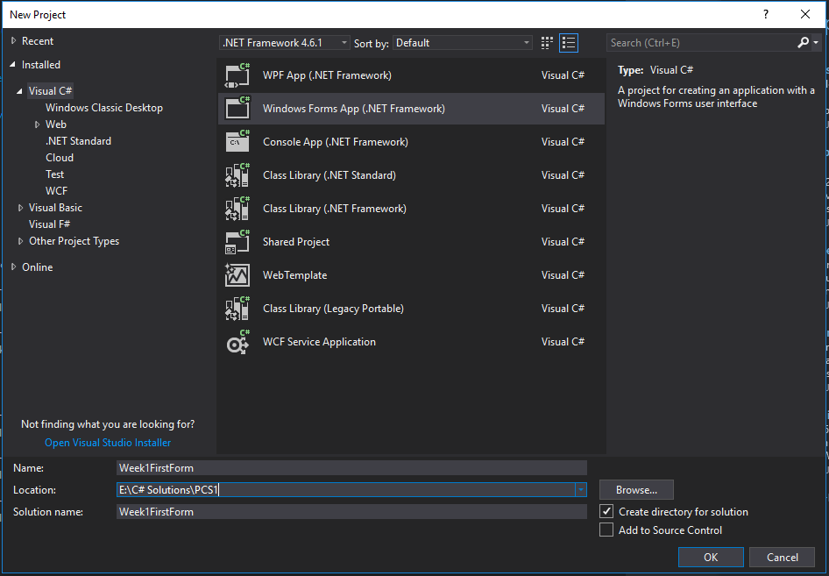
Guidelines
Create a WinForms application: File -> New -> Project
Language support
Type of the
project
Name of the
project

Slide 31
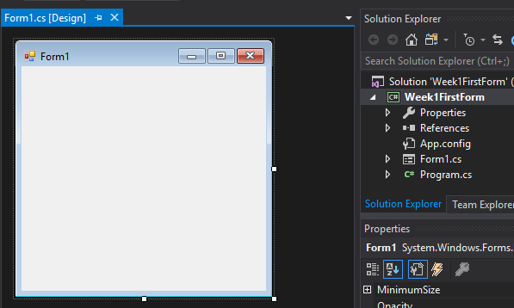
Guidelines (cont.)
Result
Empty Form
Contents of your
solution
Properties of selected control – in this case, the Form (e.g. text, size, background color)

Slide 32
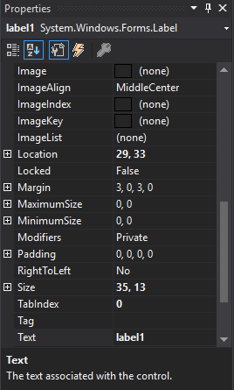
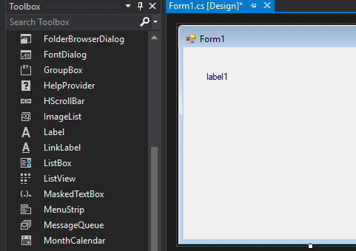
Information: Controls
Drag-and-drop a Control on the Form from the Toolbox
Access the Toolbox from View -> Toolbox
Available Controls
Drag-and-drop
Default properties of the selected Control – in this case, the Label
Notes:
Show how to modify them.
The properties can be displayed by category or alphabetically

Slide 33


Demo
Create the first Windows Forms Application in Visual Studio.
Notes:
Write a simple hello world app

Slide 34
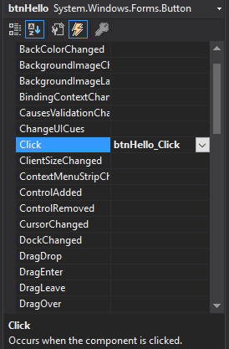
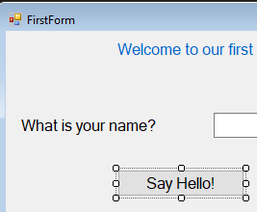
Information: Controls (cont.)
Allow behavior by adding an Event
Button
Events of selected control
Notes:
Show how to modify them.

Slide 35
Information: Controls(cont.)
The code that should be executed when the button is clicked goes in the EventHandler
private void btnHello_Click(object sender, EventArgs e)
{
//Code here gets executed everytime the button is clicked
}

Slide 36
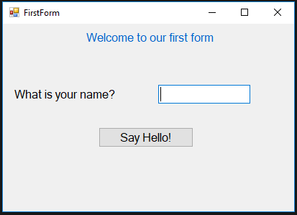
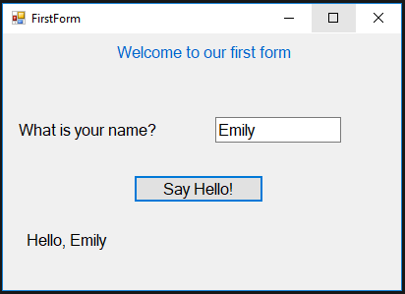
Examples
A simple app to input a name
Type a name,
then click the
button

Slide 37
Your turn!
Build this app:
Type a name,
then click the
button

Slide 38
Extra information
Give descriptive names to Controls, using a prefix to indicate the type of Control, followed by the purpose of the Control.
lblTitle
lblName
tbName
btnHello
lblResult

Slide 39
Questions?

Slide 40
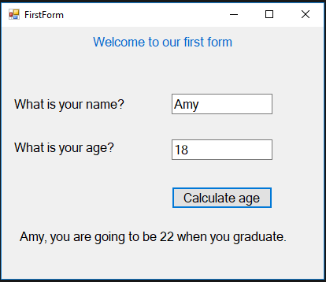
Intro: Variables
Programs are processed through statements
There should be a way to remember the data (store data)
Variables: define a variable; assign a variable; modify a variable
Retrieve the information, then perform calculations, finally display it.

Slide 41
Variables: Syntax
Variable declaration
Variable assignment
<type> <identifier>;
<identifier> = <value_or_expression>;

Slide 42
Variables: Syntax (cont.)
Type | Description | Values
int | Numbers without decimals (integers) | -5; 0; 124
string | Text | “students”; ““
float | Numbers which may or may not contain decimals | 124; 1254.65
double | Numbers which may or may not contain decimals Double is more precise than float (64 bits) | 124; 1254.65
decimal | Numbers which may or may not contain decimals Decimal is more precise than double (128 bits) | 18.8m
bool | Boolean values | true; false

Slide 43
Examples
int age;
string name = “Bob”;
age = 18;
string month = tbMonth.Text;
int a, b, c;
a = 10; b = 20; c = 30;
a = b + c; //a has now value 50
a = a + 1; //a has now value 51
bool youAreYoung;
youAreYoung = age < 25; //true

Slide 44
Examples (cont.)
int flupke = 67;
// a variable declaration followed by an assignment
flupke = 4.63; // oops! not possible!
float quick = 7.56;
quick = flupke + 4.63; // yes, is possible.
// flupke is automatically converted to a float
flupke = 4,63; // oops! not possible!

Slide 45
Extra information
Give descriptive names to variables.
Use Controls to read information and display information.
The information retrieved from TextBoxes through their property Text is String.
Convert between String and Int
Convert has options for all the different types
int age = Convert.ToInt32(tbAge.Text);

Slide 46
Your turn!
Extend your first app to store the name in a variable.
Notes:
Define a variable in the Button click and use it there (no global variables)

Slide 47
Questions?

Slide 48
Intro: Operators
How to perform calculation in an application?
Manipulate data stored in the variables.
Arithmetic operators

Slide 49
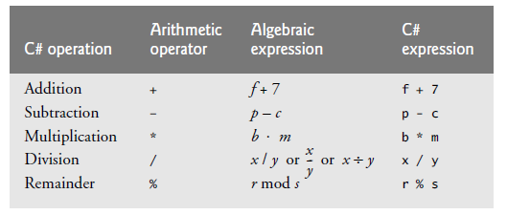
Syntax
Higher priority
Operators | Associativity
* / % | left to right
+ - | left to right
= | right to left

Slide 50
Extra information
The semantics of an operator depend on the types of the variables
//integer addition
int age = 18;
int ageAtGraduation = age + 4; //newAge = 4;
//string “addition” = concatenation
string name = “Amy”;
string result = “Hello, ” + name; //result = “Hello, Amy”

Slide 51
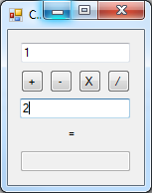
Your turn: let’s build a calculator!
TextBox
Button
TextBox
Label
Read only TextBox

Slide 52
Questions?

Slide 53

Summary
Get started with AD
Get started with programming languages
Create a WinForm application
Use variables to store and convert data
Use operators to manipulate data

Slide 54


What to do next?
Assignments week 1
Suggested reading:
Bell & Parr chapters 1-4 (the graphics part of chapter 3 is optional)

